Slide 1
Secure Transportation Management System using Edge Computing for smart city: Challenges and Future Implementations
Instructor: Annajiat Alim Rasel
RA: Humaion Kabir Mehedi
ST: Ehsanur Rahman Rhythm
Team No: 30
Group Members:
Shishir Kumar Das - 23366019
Maymuna Rukaiya - 23266019
Khairun Nisa - 23266001
Mahdi Hossain - 20301194

Slide 2
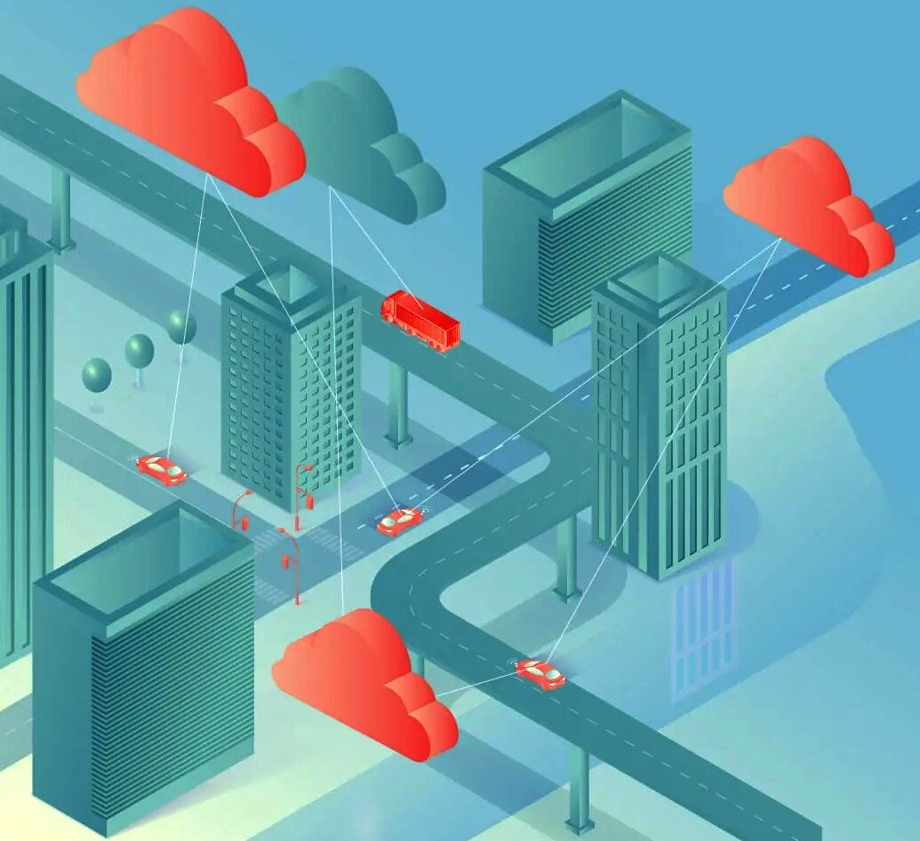
Introduction
The increasing urbanization and population growth have made the management of transportation systems in cities a complex task.
The concept of smart city aims to improve the quality of life by using technology to improve the efficiency of services and meet residents' needs.
A secure transportation management system is a crucial component of a smart city, ensuring efficient and safe commuting.
Edge computing is a promising technology that brings computing closer to the source of data, enabling real-time data processing and decision making.
This research explores the challenges and future implementations of using edge computing in secure transportation management systems for smart cities.

Slide 3
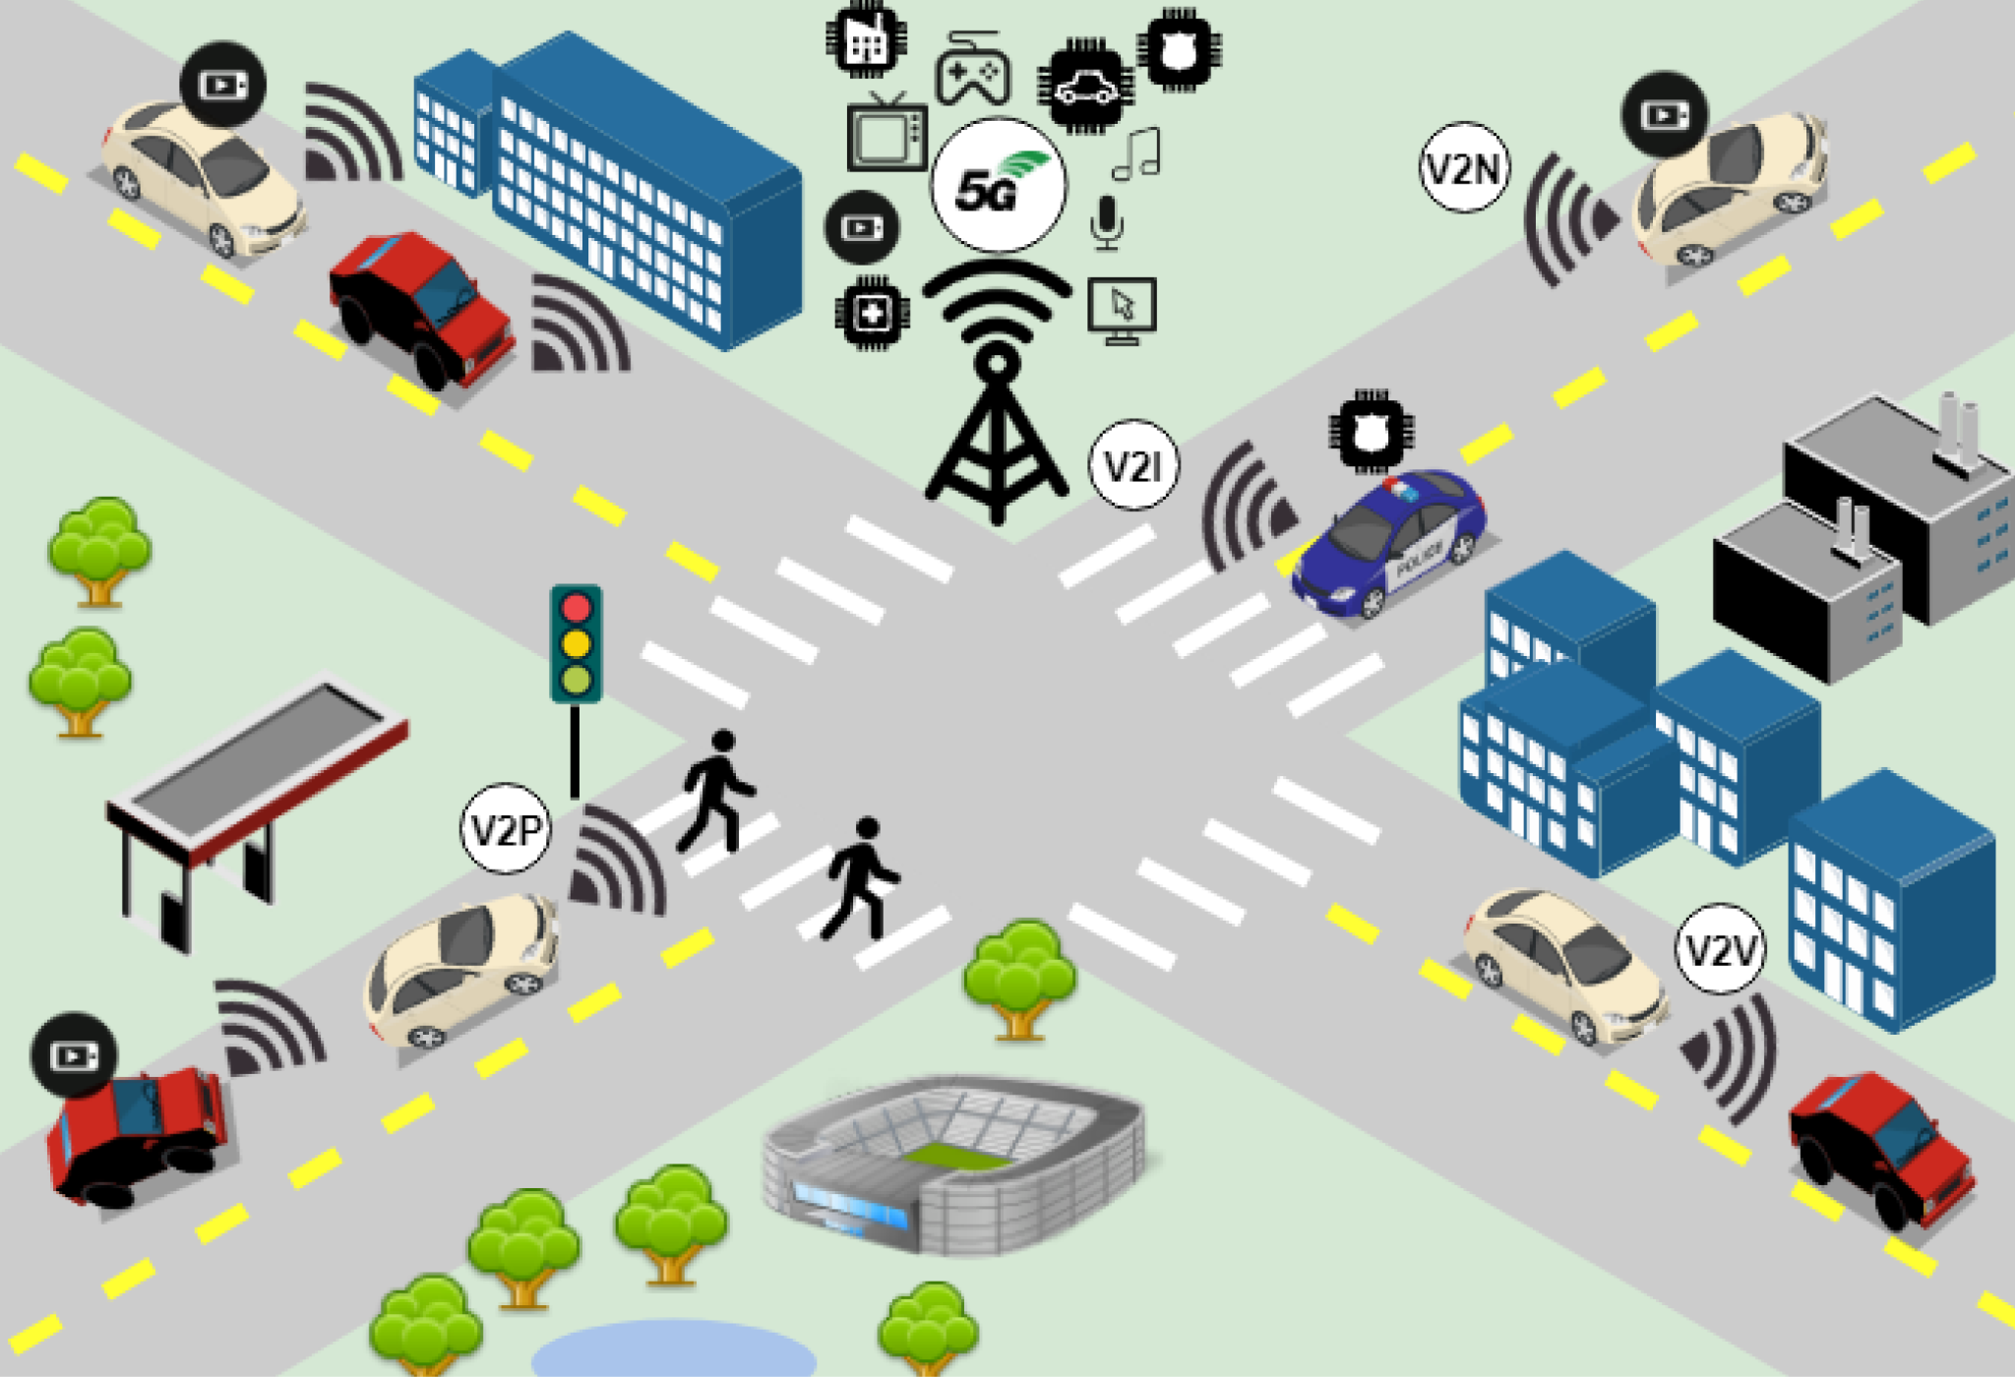
Background
Intelligent Transportation Systems (ITS) have evolved through the integration of information and communication technologies, which help manage traffic flow, reduce congestion, and enhance safety.
Autonomous vehicle behavior prediction has been a significant focus in research, with deep learning methodologies improving prediction accuracy.
Extensive studies have explored the use of edge computing in transportation systems, which has applications ranging from real-time traffic information to supporting autonomous driving.
Overcoming these challenges and integrating emerging technologies is the future of secure transportation management systems

Slide 4
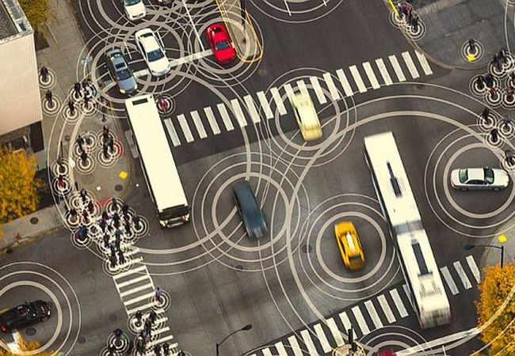
Related Works
Smarter traffic prediction using big data, in- memory computing, deep learning and GPUs
An automatic traffic density estimation using single shot detection (SSD) and MobileNet-SSD
Real-time detection and tracking of pedestrians in CCTV images using a deep convolutional neural network

Slide 5
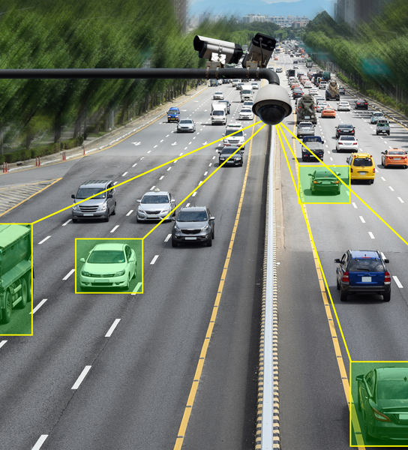
Related Works
Design and implementation of a smart traffic signal control system for smart city applications
A promising approach to people flow assessment in railway stations using standard CCTV networks
Smart city and IoT

Slide 6
Challenges
Security and Privacy Concerns:
Protecting data privacy and ensuring secure communication between edge devices is crucial.
Preventing unauthorized access to sensitive traffic data and system vulnerabilities.
Real-Time Processing and Low Latency:
Processing data in real time at the edge requires high computing power and efficient algorithms to minimize latency.
Ensuring that edge devices can handle the processing load without compromising performance.
Scalability and Integration:
Integrating diverse traffic management systems and sensors while ensuring scalability as the city expands.
Compatibility and integration of different hardware and software components across the city's infrastructure.

Slide 7
Challenges
Reliability and Redundancy:
Ensuring continuous functionality in case of device failure or network issues.
Implementing redundancy and failover mechanisms to maintain uninterrupted traffic management.
Data Management and Analytics:
Handling vast amounts of data generated by sensors and devices, and processing it efficiently.
Implementing advanced analytics for better traffic predictions and decision-making.
Resource Constraints:
Edge devices might have limited resources (processing power, memory, energy), necessitating optimization techniques.

Slide 8
Conclusion:
This paper examined some of the primary problems with edge computing caused by design flaws and how these problems may affect end devices.
Apart from side-channel attacks, protocol or implementation errors are the primary causes of problems in edge systems.
We determined that transportation system security needs to be improved based on the state of the art.
More investigation is needed into the IoV and edge computing paradigms.
Putting in place an appropriate framework will help achieve this.

Slide 9
Future Work:
In terms of future directions, the proposed system could be enhanced further by taking various features into the version like real-time data to drivers.
Future research will focus on dynamic traffic signal control functionality and performance in low-light environments or during extreme weather.
The system’s real-time implementation, which includes IoT security features in the communication layer, the architecture must be expanded to a whole end-to-end system with central server communication.

Slide 10
THANK YOU

